Slide 1
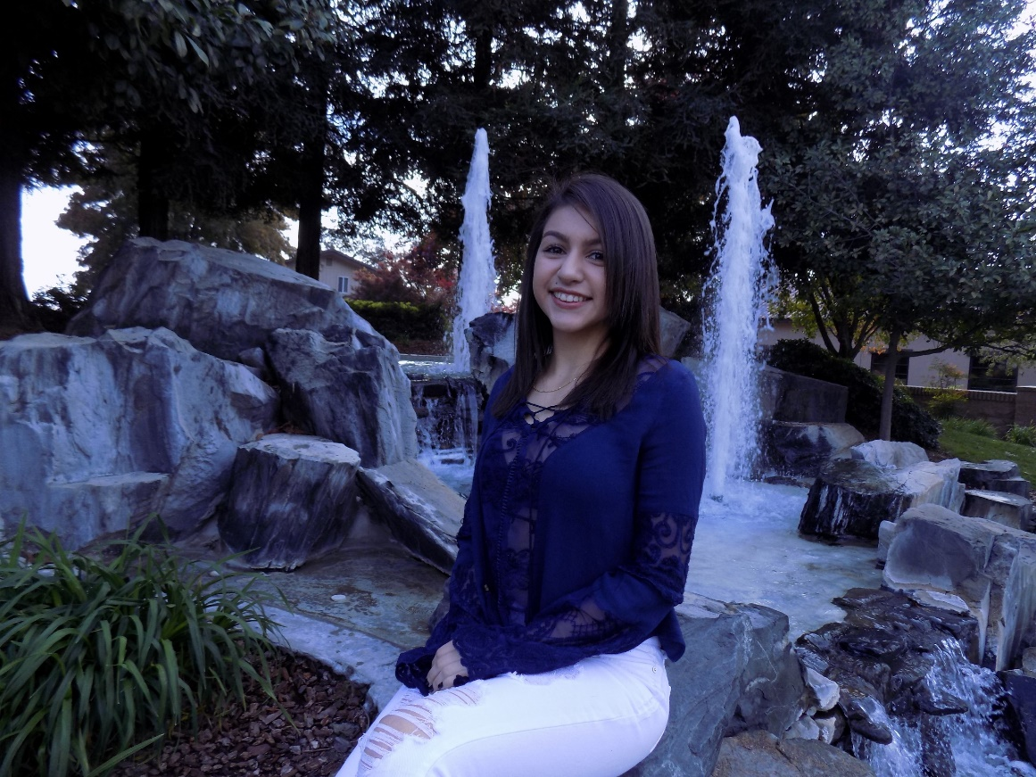
Carina Mora
Lindsay High School
Class of 2017

Slide 2
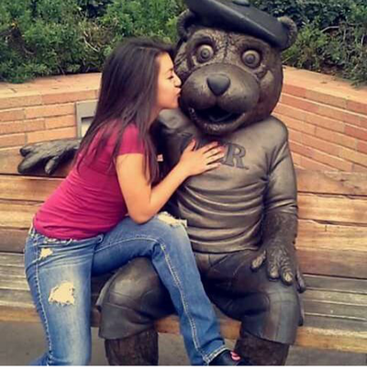
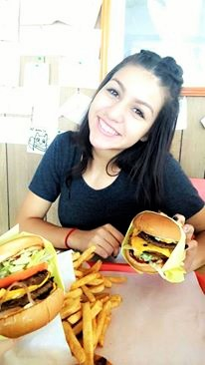
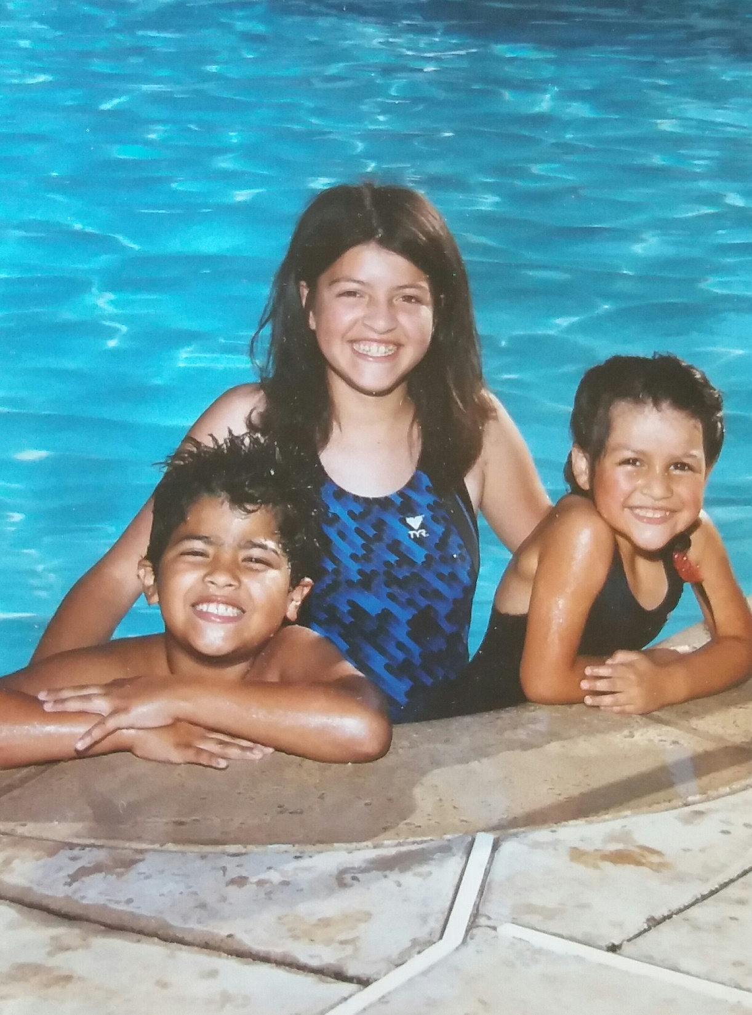
About me
Family of 7
Born in Lindsay, Ca
Love sports

Slide 3
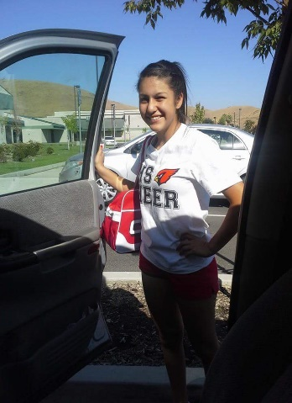
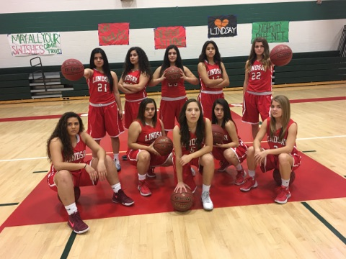
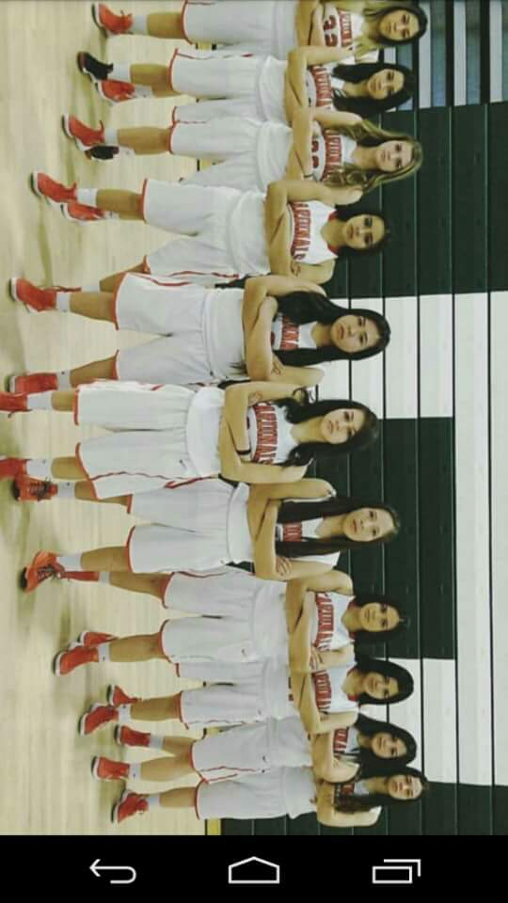
High School Experience
Clubs & Activities:
F.B.L.A- 2 years
F.F.A- 1 year
AVID- 1 Year
Art Club- 1 year
Basketball- 4 years
Cheerleading- 2 years
Volleyball- 1 year
Softball- 1 year
What has LHS taught me?
Self motivated
Responsible
Organized

Slide 4
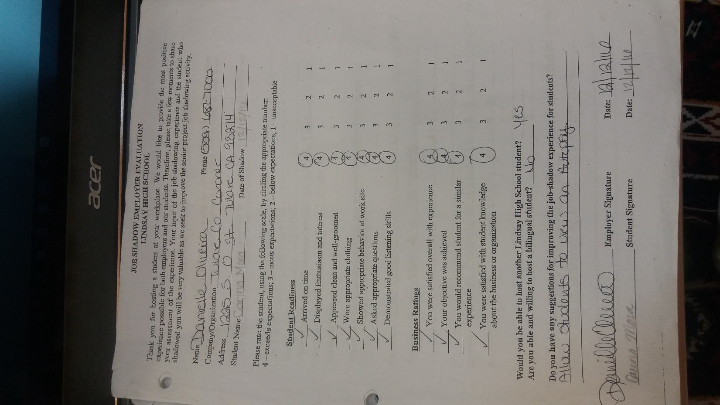
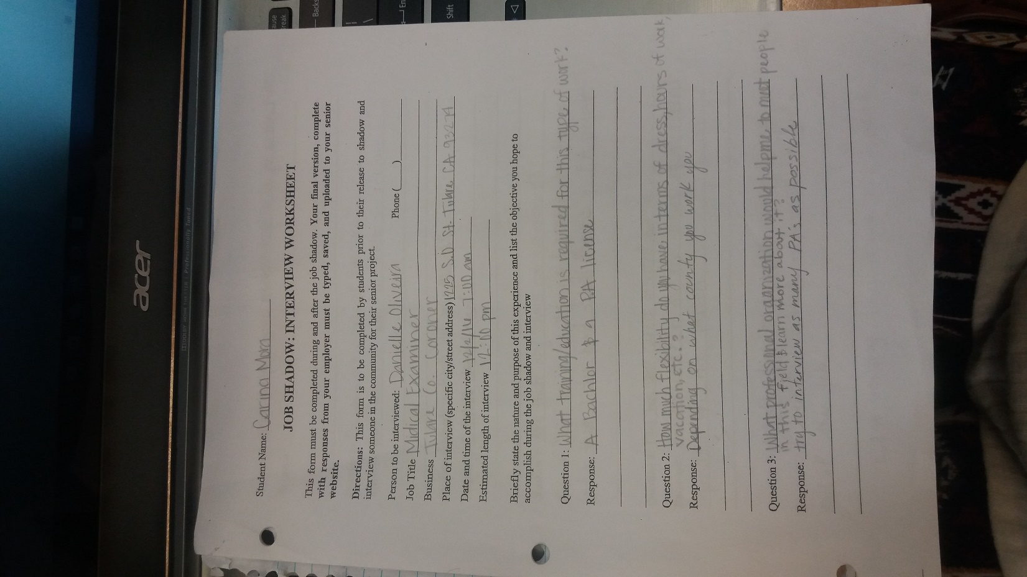
Job Shadow- Forensic Pathologist
Tulare Coroners Office
Danielle Ortiz
Learn procedures
Different situations

Slide 5
Pathway
Spanish
Big advantage
Does not relate to future career

Slide 6
Post High School Plans
Attend 4 year University
CSU Sacramento
CSU Stanislaus
CSU Fresno
CSU San Jose
Major in Criminal Forensic Behavioral Science
Attend CSU Pomona
Become a pathologist assistant

Slide 7
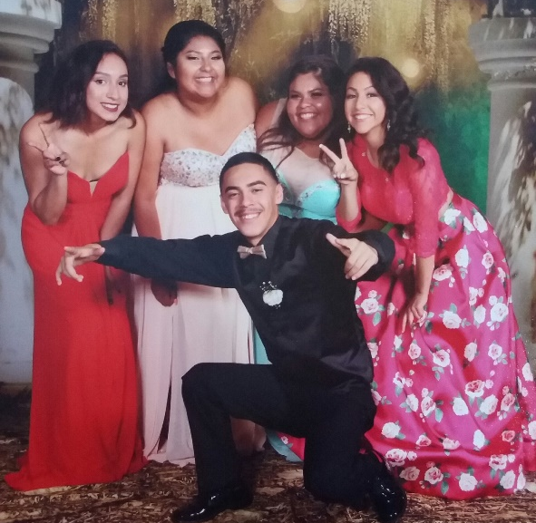
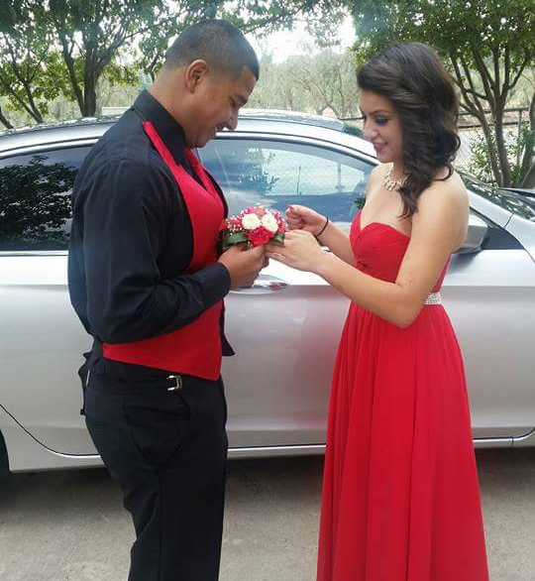
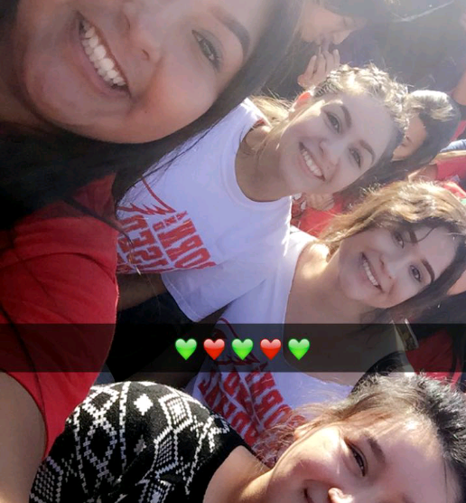
Leaving High School
What has the PBS system taught me?
Be independent
Most memorable event:
Homecoming week
School dances

Slide 8
Thank you for your time. Any questions?

